Slide 1
CS4499/5599: Data Science and Applied Machine Learning
Class Lecture: April 12th, 2023

Slide 2
Objectives
Last time:
Applying conditional probabilities to train Naïve Bayes Models
Today:
Support Vector Machines
Introduction to Unsupervised Learning
Clustering
K-means

Slide 3
Support Vector Machines
Support Vector Machines (SVM) is one of the most popular supervised machine learning techniques in use today
SVM is a very versatile approach that can be used in both regression and classification
SVM is best suited for use with small and medium sized datasets
SVM is similar to kNN, DTs and logistic regression where we will use a decision boundary to separate our classes
The key difference is that SVM uses a straight line for the decision boundary (referred to as linearly separable)

Slide 4
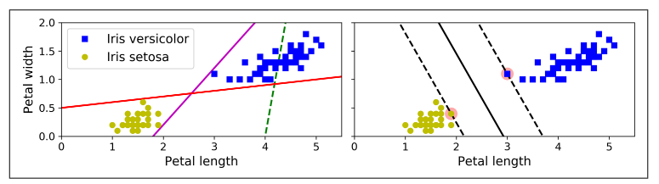
Support Vector Machines
Consider this figure from Geron:
What are some issues with the three classifiers on the left?
The graph on the right represents a SVM classifier and you will notice there is a large gap between the instances and the decision boundary

Slide 5
Support Vector Machines
Consider this figure from Geron:
The two highlighted instances, are known as support vectors
These are the two datapoints closes to our decision boundary (also known as the hyperplane)

Slide 6
Forms of SVM Classification
When preforming “linear” classification, we two rules we can impose for our model:
Hard margin classification
Soft margin classification
With Hard margin, we strive to keep data points off the gap between the support vectors and the hyperplane
When working with a Hard margin the classification is extremally sensitive to outliers
This only works if our data is linearly separable

Slide 7
Soft Margin Classification
Soft Margin classification allows our model to be more flexible
Our goal is to balance the distance between support vectors, with the number of violators (points between the SV and the hyperplane)
One of the most important hyperparameters for this type of classification is known as the C value (or just C)
C allows us to control the distance between support vectors, a high value of C means a smaller distance (and lower number of violators) and a lower C means the opposite

Slide 8
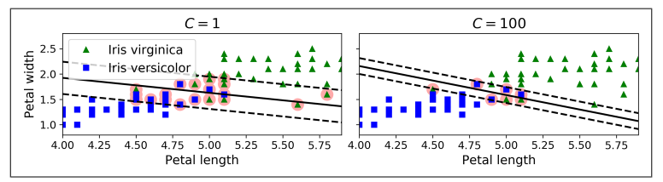
Soft Margin Classification
A high C value also increases the chances your model will be overfit
Although violators are considered bad, the model on the left (more prone to misclassifications) will likely generalize better than the one on the right

Slide 9
Nonlinear SVM Classification
Linear SVM is a very efficient approach for training a machine learning model
However, many dataset are not linearly separable, there are two commons ways we can deal with this:
We can use a polynomial kernel (a hyper parameter we can specify)
We can implement a similarity function using a Gaussian Radial Basis Function (RBF) (again we specify this with the kernel hyperpameter)
Note that a kernel method will add a high degree of complexity to your algorithm (typically O(n² )to O( n³ ))

Slide 10
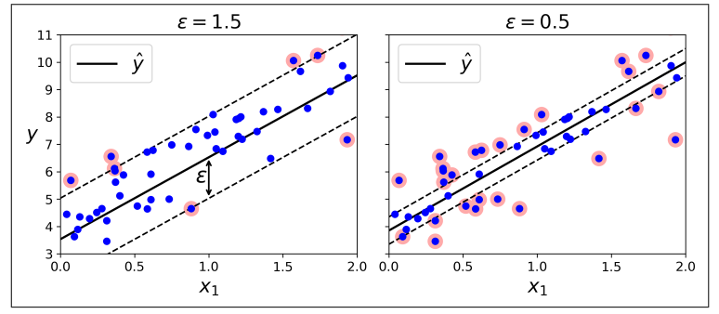
SVM Regression
As mentioned, SVM can also be used to train regression models
Instead of limiting the number of instances between the support vectors, we want as many instances as possible in between

Slide 11
SVM Regression
The width between the support vectors is controlled by the hyper parameter ε
With regression, adding new instances will not affect our model’s performance, so the model is considered ε-insensitive
Just as was the case with classification, if a linear model doesn’t fit your data, you can use a kernel to try and address this issue
However, remember using a kernel like RFB will introduce more complexity to your model and require more computation time

Slide 12
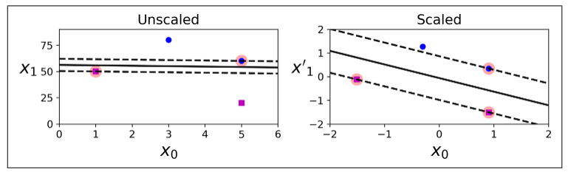
Feature Scaling with SVM
SVM models are very sensitive to feature scaling, without scaling you will notice a big difference in the quality of your models

Slide 13
Sklearn SVM Classes
Sklearn has several classes you can use to train SVM models
For linear SVM models you can use:
sklearn.svm.SVC (good for smaller datasets)
sklearn.svm.LinearSVC (scales better for larger datasets)
sklearn.linear_model.SGDClassifier (Also very good for larger datasets)
If you want to train a Nonlinear SVM model, it easiest to add the kernel you need with the ‘kernel’ hyperparameter with SVC
As you may have guessed SVM classification only works with binary classification, to train a multi-class model you will need to use One Vs. One approach we discussed before

Slide 14
Sklearn SVM Classes
For regression SVM models using the class:
sklearn.svm.SVR
sklearn.svm.LinearSVR
sklearn.linear_model.SGDRegressor
As a find note, we have really only scratched the surface on how SVM models work
There is still a significant amount of work being done under the hood to train these models
That said, this should give you all the information you need to work with SVM models

Slide 15
Unsupervised Learning
In this class we have focused on problems and datasets where we have information on the outcome
In regression, we have data that contains known values, like those we want to predict
In classification, we have data that fits a known group and try and classify new samples to those groups
Having the labels allows us to create powerful models, but in reality, there will be more cases where our data will not have a target label
In these cases, we must make use of a different approach for training models, known as unsupervised learning

Slide 16
Unsupervised Learning
In the greater scheme of things, having effective unsupervised learning models is probably the end goal of machine learning
The potential is much greater in this area than it is with supervised learning (though that is great too!)
Consider you want to develop a machine learning algorithm that can identify defects in a product using pictures
If we were to use a supervised learning model like kNN, decision trees ,etc. what would we need?

Slide 17
Unsupervised Learning
The first issue with a supervised model is we need to label all our images “defect” or “no defect”, if we have thousands of images that might take time and cost a lot
A supervised learning model would likely have to be trained on a small subset a photos, which would limit its effectiveness
In cases like this, a supervised learning model also places severe limitations on us
The supervised learning model can only identify defects its trained on, we want something that can identify not only defects we know about, but also those we don’t know

Slide 18
Unsupervised Learning
Unsupervised learning is used in three major applications:
Clustering, where the goal is to group instances that are “similar” together into groups
Anomaly detection, where the goal is to learn what “normal” looks like and detect instances that are “abnormal”
Density estimation, where we want to estimate the probability density function (PDF) of the process that generated the data
Unsupervised learning can also be used in dimensionality reduction to help pre-process data (we will cover this very soon)

Slide 19
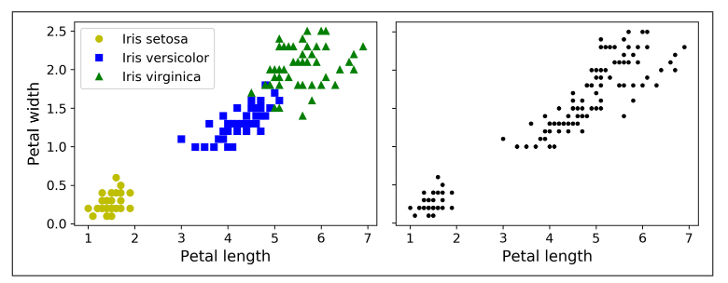
Clustering
Clustering is the approach that is most commonly associated with unsupervised machine learning
The key difference between clustering and the classification techniques we have is discussed is that clustering doesn’t make use of labeled data

Slide 20
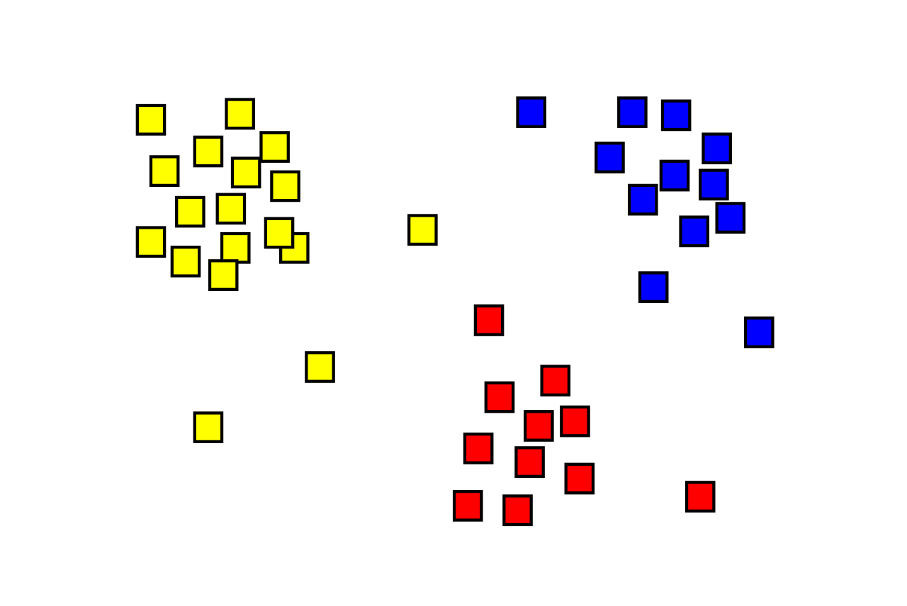
Clustering
Common applications for clustering include:
Customer segmentation
Data analysis
Dimensionality reduction
Anomaly detection
Semi-supervised Learning
Search Engines
Image Segmentation

Slide 21
Clustering
Its important to note that Clustering is a loose term, there really is not a set definition on what is and is not a cluster
Different algorithms will define clusters in their own way, for example many clustering algorithms will focus a cluster around a centroid
Other examples include:
Continuous regions of densely packed instances
Hierarchical, where the algorithm looks for clusters of clusters
We will focus on two clustering techniques
K-Means
DBSCAN

Slide 22
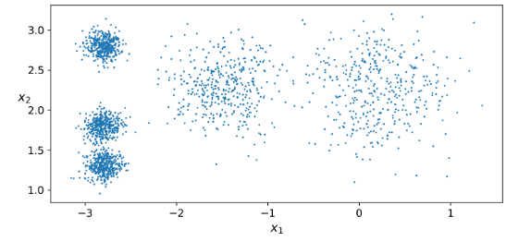
K-Means Clustering
Consider the following figure from Geron:
How many “blobs” or clusters do you see?
This type of data is perfect for clustering using K-Means

Slide 23
K-Means Clustering
K-Means was first proposed by Stuart Lloyd in 1957 at Bell Labs, where the technique was used pulse code modulation
Bell Labs would publish the code in the 1982
Edward W. Forgy, published a similar algorithm in the 1965, so K-Means is sometimes referred to as Lloyd-Forgy clustering
When training a K-Means model, we need to specify the number of clusters (K), we want the model to find
In our example, it was easy to tell we need 5, but as we add more dimensions to our data, and data become less grouped this becomes much harder

Slide 24
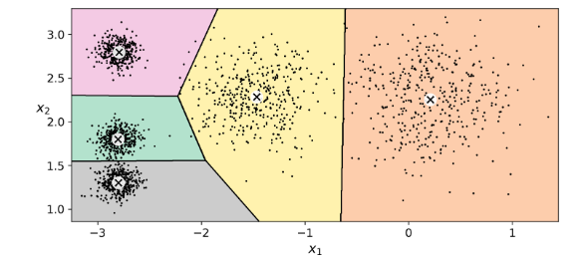
K-Means Clustering
If we add the decision boundaries to our blobs, we get what is known as a Voronoi diagram or Voronoi tessellation
You can probably guess as instances get boundary the chance of them being misclassified increases

Slide 25
K-Means Clustering
K-Means doesn’t perform as well when we have data clusters of vastly different diameters
Typically, we use what is known as hard clustering which only allows a point to be assigned to a single cluster
We can also assign each instance a score, usually the distance between the centroid and the instance (similar kNN, with the distance between points)
You can also use a similarity function such as Gaussian Radial Basis Function
These scores can used for dimensionality reduction

Slide 26
K-Means Clustering
A challenge of training a K-Means model is finding the optimal centroid for our data
This is an iterative process; our first step is to randomly choose a point to be our centroid
Then we label our instance (define our decision boundaries), and update our centroid, until our centroid stops moving
The centroid will usually become relatively stable and converges within a few iterations
In terms of complexity K-Means can be very efficient, if our data has a good clustering structure this will be O(n)

Slide 27
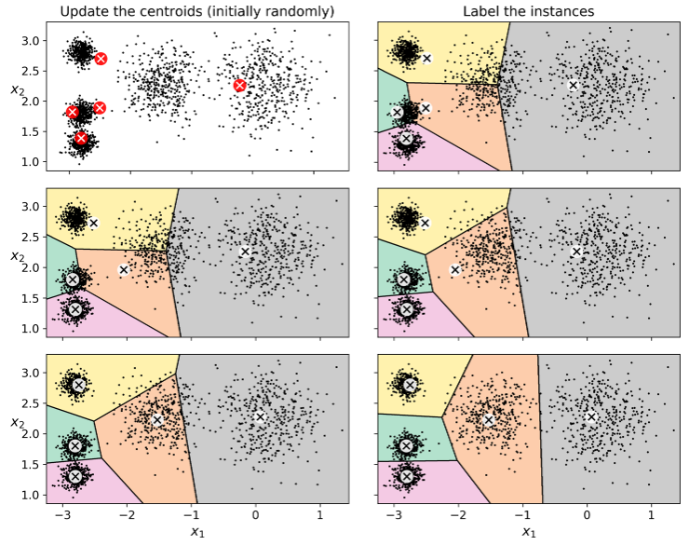

Slide 28
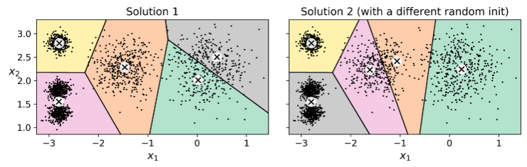
K-Means Clustering
Now while our centroids will eventually converge, there is no guarantee it will converge to the best solution
Notice that our random points converged to a local optimum rather than the actual 5 clusters we wanted

Slide 29
K-Means Clustering
There are some techniques we can use to reduce the chances of this happening:
If we have an approximation of where the centroids should be we can, specify these points as are starting points
A more likely approach is that we run the algorithm several times and keep the best solution
Most K-Means algorithms will allow you to specify the number of time your run the algorithm (sklearn uses 10 by default)
In terms of computation time this is fine, as K-Means is simple and usually one of the fastest machine learning techniques we have

Slide 30
Calculating Centroids
How do you we know which is the results is the best?
We can use a metric known as model inertia to evaluate our iterations
Inertia is simply the mean squared distance between each point and its closest centroid
We keep the results that have the lowest inertia
Sklearn does have a method to get the inertia (.inertia_) but be very wary of using .score with K-Means as it is possible to get a negative value

Slide 31
Improving K-Means
There have been several improvements that have been introduced to improve the process of calculating centroids:
K-Means++, which seeks to ensure centroids are further away from each other
The first centroid is placed at random, and probabilities are used to ensure the next centroid is a distance D(x^{j}) away from the first
Accelerated K-Means, which looks to reduce computation time by reducing the number of distance calculations needed
Sklearn uses both of this improvements by defaults

Slide 32
Mini-Batch K-Means
Mini-batch K-Means will use small subsets of the dataset rather than the entire dataset for each iteration
This can speed up the algorithm by a lot and can allows for the use of very large datasets that would not fit into memory otherwise
However, the inertia tends to be higher with these types of models, especially as k increases
Sklearn has a class for mini-batch K-Means: sklearn.cluster.MiniBatchKMeans

Slide 33
Optimal Number of Centroids
Another major consideration for a training a K-Means model is the number of clusters we will create
Our example showed 5 clear clusters, but it in application this will rarely be obvious
This may be the most important consideration, as a poor k number will likely result in a poor model
If we use too many clusters, we will cut-up good clusters into smaller clusters we don’t need
If we use to few clusters, our clusters will start merging into large less useful clusters

Slide 34
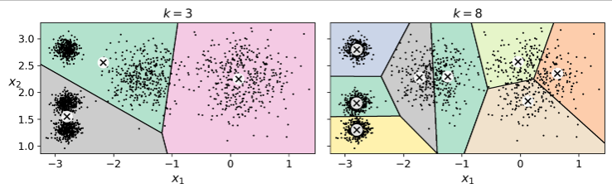
Optimal Number of Centroids
Consider these versions of our previous example
An easy trap to fall into is to only consider the inertia value for our data, however this is not always the case (the inertial value for k=8 is 119.1 vs 211.6 for our example)

Slide 35
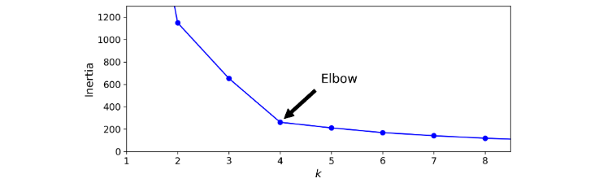
Optimal Number of Centroids
In fact, as the number of clusters increases the inertia decreases
You will notice that at k=4 we have a major inflection point for our inertia values, after 4 the improvement in inertia is minimal

Slide 36
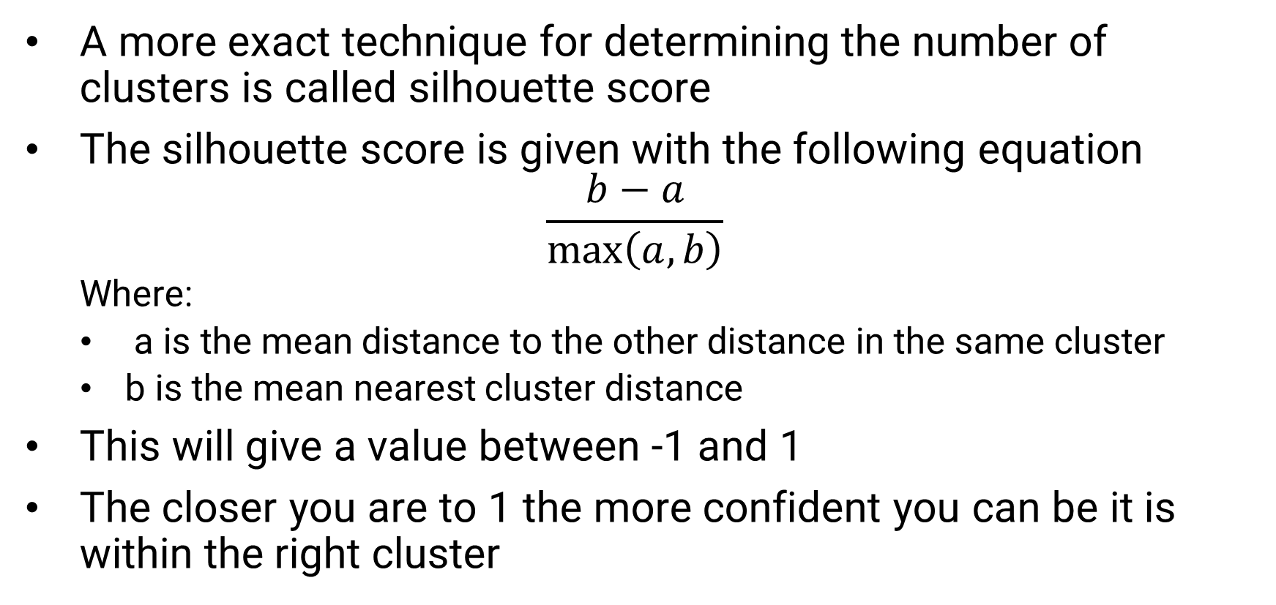
Silhouette Score
A more exact technique for determining the number of clusters is called silhouette score
The silhouette score is given with the following equation
$$\frac{b−a}{\max\left(a,b\right)}$$
Where:
a is the mean distance to the other distance in the same cluster
b is the mean nearest cluster distance
This will give a value between -1 and 1
The closer you are to 1 the more confident you can be it is within the right cluster

Slide 37
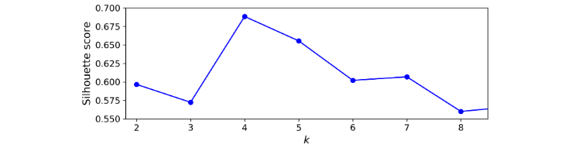
Silhouette Score
Let’s look at the silhouette score for our blobs example:
From this you can tell both 4 and 5 are excellent choices for your k value
Sklearn has a function for silhouette score sklearn.metrics. silhoutte_score

Slide 38
Pros and Cons of K-Means
K-Means is a popular choice in the area of unsupervised learning because:
Fast
Scalable
However, there are a number of issues with the approach that should be considered:
It is a very iterative process (finding the right centroid, finding the optimal k, etc.)
K-Means does not like clusters that vary significantly in size, shape, or density

Slide 39
Next Time
Move on to Unsupervised Learning:
Discuss DBSCAN Clustering
Dimensionality Reduction
Homework 7 is due Monday 4/17
The undergraduate final project will also be assigned

